Slide 1
Chapter 13 Data Visualization and Exploration
Stephen F Elston | Principle Consultant , Quantia Analytics, LLC

Slide 2
Chapter Overview
Exploratory data analysis
The R ggplot2 package
The Python Pandas plotting and matplotlib package

Slide 3
Exploratory data analysis
Explore the data with visualization
Understand the relationships in the data
Create multiple views of data
Use conditioning
Understand sources of model errors
John Tukey, Exploratory Data Analysis, 1977, Addison-Westley

Slide 4
Views of data
Relationships in data can be complex
Data exploration requires multiple views
Conditioned (faceted) plots are ideal

Slide 5
Different plots for different views
Scatter and line plots
Bar plots
Histograms
Box plots
Violin plots
Q-Q plots

Slide 6
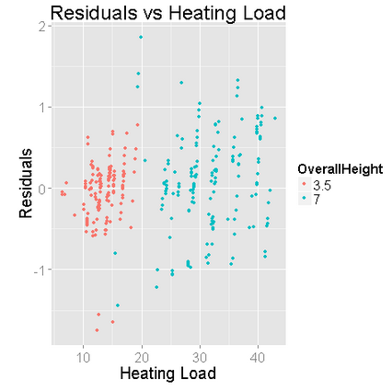
Scatter plot

Slide 7
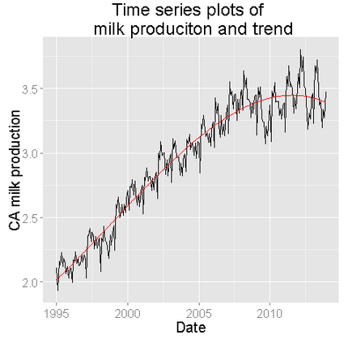
Line plot

Slide 8
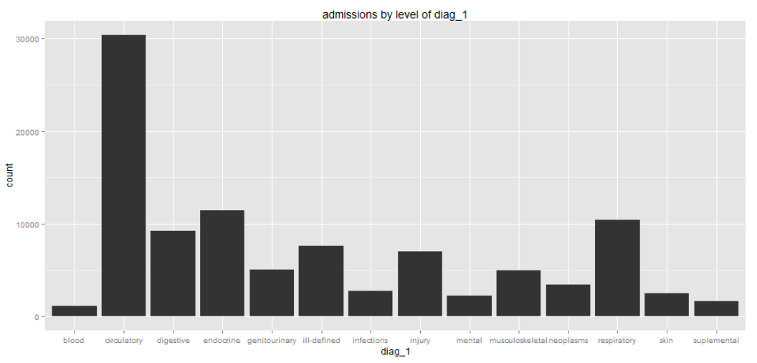
Bar Plot - unordered

Slide 9
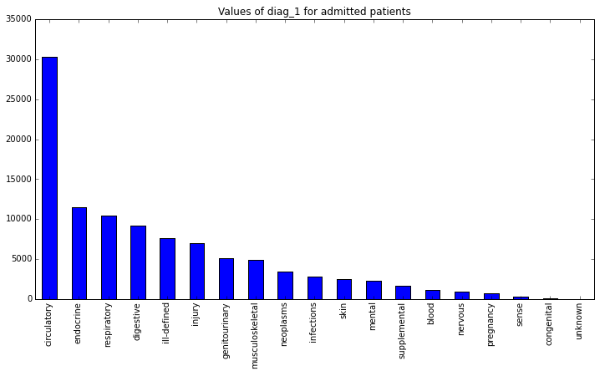
Bar Plot - ordered

Slide 10
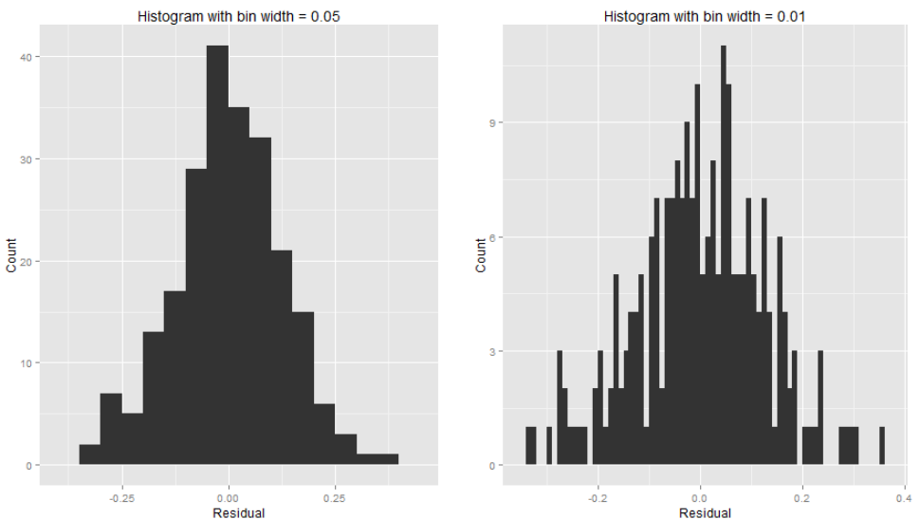
Histogram

Slide 11
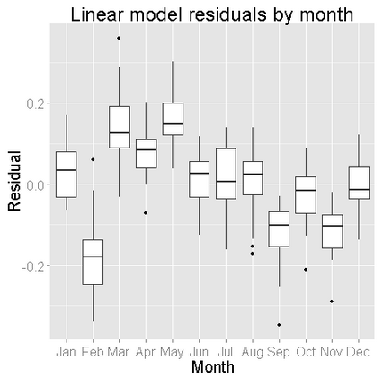
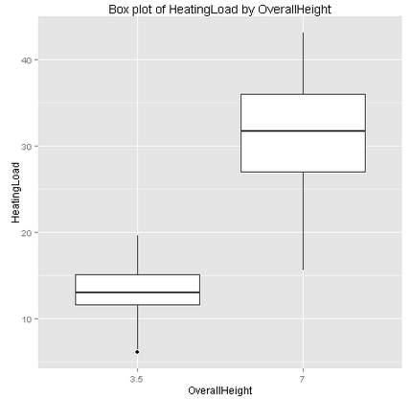
Box Plot

Slide 12
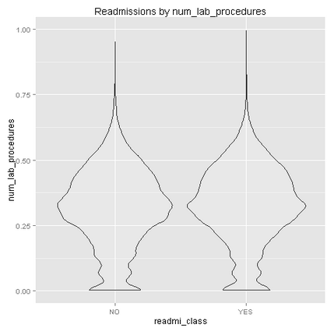
Violin Plot

Slide 13
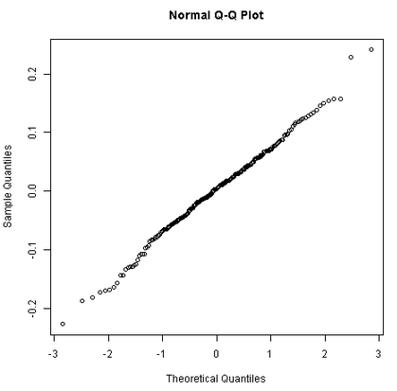
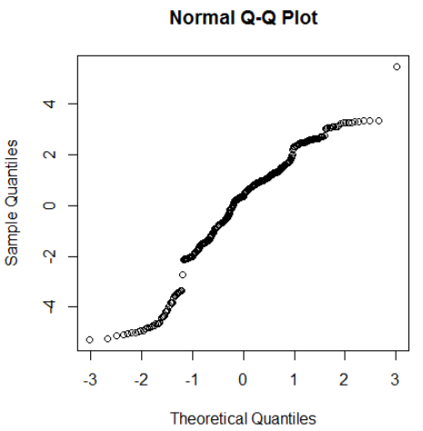
Q-Q Normal Plot

Slide 14
Conditioning (faceting)
Project multiple dimensions onto two
Plots of subsets (group by )
A
A
A
B
B
B
A
B

Slide 15
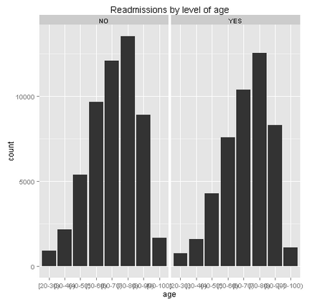
Conditioned Histograms

Slide 16
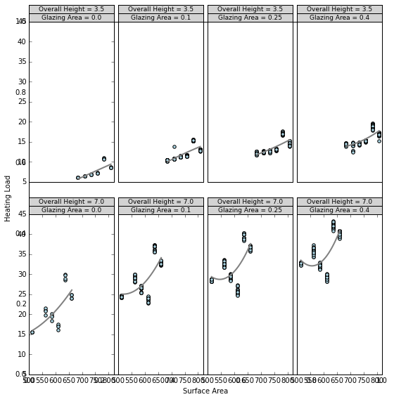
Conditioned Scatterplot

Slide 17
Introduction to ggplot2

Slide 18
Overview of ggplot2
Produces presentation quality charts
Uses grammar of graphics
Operators define graphics properties
Operators chained to create complex plots
Ultimately replaced by ggvis

Slide 19
The Grammar of Graphics
Import library
Chain methods to define plot
Add attributes to chain
library(ggplot2)
ggplot(dataframe, aes(x = xcol, y = ycol, by = opt)) + geom_plottype(arguments)
+ xlab("X label") + ylab("Y label") + ggtitle("Title") + other_properties()

Slide 20
Ggplot2 Types
geom_bar
geom_boxplot
geom_histogram
geom_line
geom_point
stat_smooth
stat_hexbin

Slide 21
Ggplot2 Options
facet_grid()
xlab(), ylab()
ggtitle()
shape
color
alpha
size

Slide 22
Introduction to pandas plotting and matplotlib

Slide 23
Pandas Plotting
Define backend
Import libraries
Define and clear a figure
Define one or more axis
Apply plot method
Save figure
import matplotlib
matplotlib.use('agg')
import matplotlib.pyplot as plt
fig1 = plt.figure(figsize=(9, 9))
fig1.clf()
ax = fig1.gca()
pandas.DataFrame.plot(kind = 'someType', ax = ax, ….)
fig1.savefig('scatter2.png')

Slide 24
Python Plotting in Azure ML
def azureml_main(frame1):
# Set graphics backend: Do this first!
import matplotlib
matplotlib.use('agg')
import matplotlib.pyplot as plt
fig1 = plt.figure(figsize=(9, 9)) ## Define a figure
fig1.clf() ## Clear the current figure
ax = fig1.gca() ## Define axis to plot
pandas.DataFrame.plot(kind = 'someType', ax = ax, ….)
fig1.savefig('scatter2.png') ## Save figure in a file for output
return frame1

Slide 25
Types for pandas.DataFrame.plot()
‘line’ : line plot (default)
‘bar’ : vertical bar plot
‘barh’ : horizontal bar plot
‘kde’ or ‘density’: Kernel Density Estimation plot
‘scatter’ : scatter plot

Slide 26
Options for pandas.DataFrame.plot()
ax – pyplot axis
x, y – coordinates
color – line or symbol color
s – size by value
alpha – transparency

Slide 27
matplotlib.pyplot
pandas.DataFrame.plot built on matplotlib.pyplot
For some methods use matplotlib.pyplot directly

Slide 28
Summary

Slide 29
Summary
Data visualization essential to understanding
The R ggplot2 package
The Python Pandas plotting and matplotlib package

